Slide 1
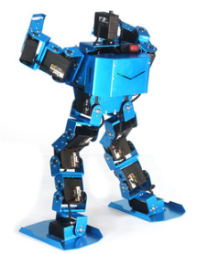
Biped Robot
Fahad
Mohammed
Naif

Slide 2
Introduction
The is a Design project to make a robot which provide a sufficient way to perform different actions
Developing a robot with the challenges
BiPed Racing
BiPed Freestyle Dancing
Balancing Robot
These actions will perform by the Robot using the remote controller to act according to the user choice

Slide 3
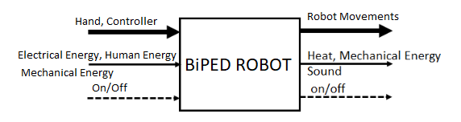
Black BOX Model
Black Model shows only the inputs and outputs of the system regardless of what is happening inside the system

Slide 4
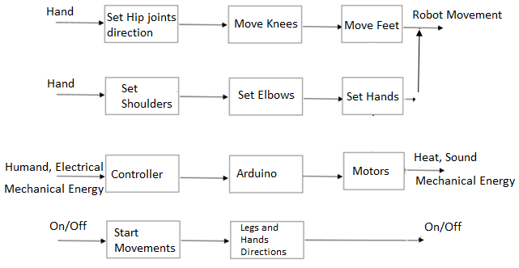
Functional Model
Functional Model represent the complete process happening inside the system

Slide 5
Concepts Generation
Concepts have generated using
Customer Requirements
Engineering Requirements
Black Box Model
Functional Model
Customer Requirements have followed to create designs which fulfill the needs of client
Engineering Requirements have used to create the designs which are according the dimensions defined in ER’s

Slide 6
Concept Generation
Black Box Model helped in generating the concepts, as inputs and outputs have defined so concepts have generated using those inputs and outputs only.
Functional model helped in generating the concepts, as the complete system has defined so the system components have set the majority parameter to use in the design and operating the design as per functional model
Each concept has compared with the functional model and check the functionality of concept matching with the functional model, if not then made such changes to get same functionality

Slide 7
Concept Generation
Concepts have generated using different techniques
Brain storming
Bio-inspired
Morphological Matrix
Brain storming ideas have generated by looking around the different robotic designs and created out own design
Bio-inspired technique used to generate the concepts by inspiring from Humans
Morphological Matrix has used to get some components and use them together to make the designs. These components have used from the functional Model

Slide 8
Concept Generation
Concept 1: Two Legged Wide Robot
Robot has motors at
Hip Joints
Knee Joints
Feet Joints
This is 6 Degree of Freedom considering each joint as 1 DOF
Capable to balance itself because of long feet and small structure
Capable of move in all directions and run like a human
Capable of show dace movements

Slide 9
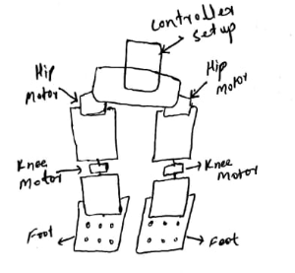
Concept Generation
Concept 1 has shown in the figure
Advantages
Good Balancing
All direction Movement
Easily standup from lay down position
Disadvantages
Difficult to stand up after falling

Slide 10
Concept Generation
Concept 2: Thin Legged Refined Robot
This robot has
Hip Joints (Long Structure)
Knee Joints
This robot can easily move forward backward
4 Degree of freedom considering each joint as 1 DOF
Hip joints have long structure to control the whole legs
Bend form of legs can help in running

Slide 11
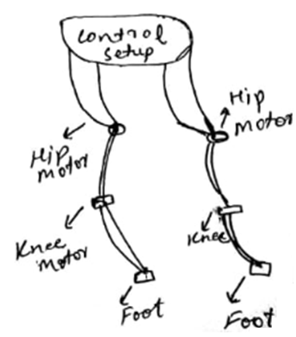
Concept Generation
Concept 2 has shown in the figure and few more concepts have shown in the Appendix.
Advantages
Long hip structure provide good control
Running is easy
Disadvantages
Balancing is difficult
Less Degree of Freedom

Slide 12
Design Evaluation
Generated concepts have evaluated using two methods
Pugh Chart
Decision Matrix
Pugh Chart
It evaluate the design on the basis of customer requirements by checking if the requirement is present in the design or not.
If requirement is present, + sign assign to that box and not present then – sign assign to that box
Sum up the + and – to count which design got highest + signs and that will be winner
Top three designs have selected from Pugh Chart out of ten designs

Slide 13
Pugh Chart
Biped ROBOT | Weight | Humanoid Robot | Two Legged Wide Robot | DATUM ROBOT | Single Structure Robot | Expanded Robot | Half Cut Robot | Spider Legged Robot | Sculpture Robot | Thin Legged Refined Robot | Mobile Robot | Morph Robot
Fits into the Door | 13 | + | + | D | + | - | - | - | + | + | - | +
Two Legged Biped Robot | 12 | + | + | D | - | + | + | + | + | + | + | S
Reciprocal Linear Mechanism | 11 | - | + | D | + | - | - |  | + | + | - | -
Forward and Backward Motion | 10 | + | + | D | + | - | S | - | - | + | S | +
Safe to Use | 9 | + | + | D | S | - | + | - | + | + | + | +
Remotely Control | 8 | + | + | D | - | + | - | + | - | + | + | +
Long battery backup | 7 | - | + | D | + | - | - | - | + | - | - | -
Smooth Transition | 6 | - | + | D | - | + | - | - | + | + | - | -
Racing speed can control | 5 | + | + | D | - | - | - | + | + | + | - | +
Capable of Balancing in all directions | 4 | - | + | D | + | - | - | - | - | + | + | -
Perform dancing | 3 | + | + | D | - | + | - | - | - | + | - | +
Reliable | 2 | - | + | D | - | + | - | - | - | + | - | -
Durable | 1 | + | + | D | - | + | - | - | - | + | - | +
Pluses |  | 8 | 13 | - | 5 | 6 | 2 | 3 | 7 | 12 | 4 | 7
Minus |  | 5 | 0 | - | 7 | 7 | 10 | 9 | 6 | 1 | 8 | 5
Total |  | 3 | 13 | - | -2 | -1 | -8 | -6 | 1 | 11 | -4 | 2

Slide 14
Pugh Chart Result
Pugh chart has evaluated each design against each requirement
Determined that most the design didn’t fulfilled as much requirements
Final results have found that top three designs are
Two Legged Wide Robot
Thin Legged Refined Robot
Humanoid Robot
Two legged wide robot is fulfilling all the requirements, capable of dancing, balancing, running, linear mechanism is present.

Slide 15
Design Evaluation
Decision Matrix
In decision matrix, each design evaluates on the basis of engineering requirement
Each design evaluate against each requirement and check how much it fulfills the requirement
Assign the marks accordingly and take the product with the weightage of that requirement
Sum up all the numbers for each design
Highest number design counts as the best design because it fulfills the engineering requirements as maximum as possible

Slide 16
Decision Matrix
Decision Matrix | Dimension | Battery Time | Walking Length capacity | Height | Foot Length | Degree of Freedom | Width | Total
Weight | 7 | 6 | 5 | 4 | 3 | 2 | 1
Two Legged Wide Robot | 6x7=42 | 6x6=36 | 4x5=20 | 6x4=24 | 6x3=18 | 4x2=8 | 5x1=5 | 153
Thin Legged Refined Robot | 4x7=28 | 3x6=18 | 2x5=10 | 4x4=16 | 3x3=9 | 2x2=4 | 2x1=2 | 87
Humanoid Robot | 2x7=14 | 3x6=18 | 3x5=15 | 3x4=12 | 2x3=6 | 2x2=4 | 3x1=3 | 72

Slide 17
Decision Matrix Result
Result of Decision matrix has shown that the top design is
Two Legged Wide Robot
It has got the highest marks as it is fulfilling the engineering requirement at maximum level
It has high capacity of walking, it has long feet, Height is sufficient, maximum degree of freedom, width is better keep the device balanced.

Slide 18
Bill of Material
Bill of Materials
Team
# | Part Name |  | Qty | Description | Functions | Material | Dimensions | Cost | Link to Cost estimate
1 | Servo Motor |  | 6 | To do the movement in each direction | Do the walking, dancing, balancing | Steel | 1.2 x 1 in | $82.74 | Ebay
2 | Steel Sheet |  | 4 | Cut the sheet to make the robot sides | Form the structure of robot | Steel | 100 x 100 mm | $38.32 | Ebay
3 | Arduino |  | 1 | Control the Robot motors | Pass the signals to each part | Silicon | 4 in x 4 in | $3.49 | Ebay
4 | Controller |  | 1 | Control the robot wirelessly | Connect with Arduino to pass signals | Plastic | 6 x 4 in | $27.99 | Ebay
5 | Blue Smurft Bluetooth |  | 1 | Connect control with Arduino | Make the connection with Controller | Silicon | 4 in x 4 in | $27.99 | Spark Fun
6 | Strap Hinges |  | 12 | Make conneciton with motor and Plates | Put on the joints | Steel | 2 in x 4 in | $26.28 | Ebay
7 | High gloss Tape |  | 1 | To hold the items on the board | Grip all the parts over the robot | Vinyl PVC | 4 x 2 in | $139.49 | Ebay
8 | Screws |  | 50 | Make the connections | Hold the joints with hinges | Steel | 0.5 x 0.1 in | $1.14 | Ebay
9 | Battery |  | 2 | Provide power to arduino and motors | Generate the electricity from storage | Li-Ion | 4 x 2 in | $97.50 | Ebay

Slide 19
Bill of Materials
Bill of Materials
Team
# | Part Name |  | Qty |  | Description | Functions | Material | Dimensions | Cost | Link to Cost estimate
10 | Battery Cells | 4 | Controller power | Provide power to the controller | Li-Ion | 3 x 1 in | $11.96 | Ebay
11 | Jumper Wires | 4 | Connect between the parts | Make all the connection for supply | Copper | 6 x 0.1 in | $4.00 | Ebay
12 | Power Adopter | 1 | To charge the battery | Provide the charging to the robot battery | Plastic | 4 x 2 in | $14.59 | Ebay
Total | $475.49
Total incl. tax | $556.32

Slide 20
Budget
Budget estimation has done in the Bill of Materials
Remaining budget will be use as
Total Budget | $1500
Estimated Budget | $556
Advertisement Budget | $200
Prototype Cost | $400
Contingency Budget | $244
Travelling etc. | $100

Slide 21
Reference
[1] https://www.ebay.com/itm/360-20KG-Waterproof-High-Torque-Metal-Gear-RC-Servo-Motor-Car-Helicopter-Boat/
[2] https://www.ebay.com/itm/STAINLESS-STEEL-SHEET-PLATE-in-Various-sizes-and-Thickness/112740090156?var=413195179173&hash=item1a3fd5412c:m:mPUwwyOw159DWFCKTJz7fqA
[3] https://www.ebay.com/itm/Arduino-UNO-R3-Mini-Micro-USB-ATmega328P-CH340G-Replace-ATmega16U2-Board/20192795
[4] https://www.ebay.com/itm/PS4-DUALSHOCK-4-Wireless-Controller-Bluetooth4-0-Gamepad-for-SONY-PlayStation-US/123895207849?hash=item1cd8bad7a9:m:mL4D1NtKRZ7718d31_Ts2fg
[5] https://www.sparkfun.com/products/12577
[6] https://www.ebay.com/itm/Strong-Heavy-Duty-Strap-Hinges-Zinc-Tee-Door-Gate-GOLD-Choose-your-pack-size/142432290165?hash=item2129a04575:m:mRej1rysKMpJj9NQ2h7a8MA
[7] https://www.ebay.com/itm/Multicolor-Adhesive-High-Gloss-Film-Vinyl-PVC-Tape-Automotive-Grade-Car-Wrap/223034541877?var=521843692188&hash=item33ede50735:g:6qEAAOSwi5dcl0Qt
[8] https://www.ebay.com/itm/M3-Black-12-9-Grade-Alloy-Steel-Allen-Hex-Socket-Cap-Head-Screw-Bolt-DIN912/182022519670?_trkpar
[9] https://www.ebay.com/itm/4-4Ah-4400mah-36v-18650-lithium-battery-pack-for-Balance-Scooter-Board-2-wheel/123902060267?_trkparms=aid%3D555018%26algo%3DPL.SIM%26ao%3D1%26asc%3D6
[10] https://www.ebay.com/itm/Safest-3-7V-18650-Charger-Lithium-Ion-Battery-USB-Rechargeable-Battery-Universal/153613634183?_trkparms=ispr%3D1&hash=item23c4160a87:m:m_p07jw_b4GxCYAdeRoJrZQ&enc=AQAEAAA
[11] https://www.ebay.com/itm/10-20-30CM-Jumper-Wire-Cable-Male-to-Male-to-Female-to-Female-Arduino-Breadboard/392315907400?_
[12] https://www.ebay.com/itm/AC110-220V-Power-Supply-Adapter-Transformer-LED-Strip-2A-3A-5A-8A-DC-5V-12V-24V/322286626497?_trkparms=ispr%3D1&hash=item4b09c7a6c1:m:mQ3El-m3_vZFy4IcfeV7aTg&enc=AQAEAAACMBPx

Slide 22
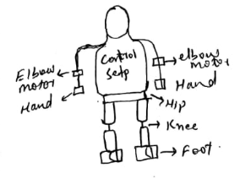
APPENDIX A – Concept 3
Humanoid Robot
Advantages
Easy to move
Disadvantages
Balancing is the issue because of height
Degree of Freedom is less
Running is the issue

Slide 23
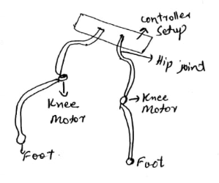
Appendix B – Concept 4
Spider Legged Robot
Advantages
Easy to move
Disadvantages
Difficult for balancing
Running is difficult
Walking all around is difficult

